Slide 1
Advanced Arduino Programming for Communications
Arnub Datta 221-15-4726
Md. Amir Hamja 221-15-4784
Abu Zahed 221-15-4716
Nurjahan Akter Mim 221-15-4782
Course Title: Embedded Systems & IoT
Course Code: CSE233

Slide 2
TABLE OF CONTENTS
HC-05 Bluetooth Module Interfacing with Arduino
SIM800L GSM/GPRS Module Interfacing with Arduino
LoRa RF Module Interfacing with Arduino
Generic RF Module Interfacing with Arduino
nRF24L01 RF Module Interfacing with Arduino

Slide 3
HC-05 Bluetooth Module
A Bluetooth module is a device that allows wireless communication between electronic devices over short distances using Bluetooth technology. It is commonly used in IoT, robotics, and home automation applications to enable wireless data transfer between devices like smartphones, computers, and microcontrollers.
Key Features:
Wireless Communication
Low Power Consumption
Data Transfer
Bluetooth Versions

Slide 4
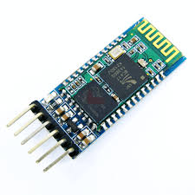
HC-05 Bluetooth Module
✔ Supports Master & Slave modes ✔ UART (Serial Communication) → Default Baud Rate: 9600 ✔ Range: ~10 meters ✔ Power: 3.3V (Tolerates 5V on RX)
Easy-to-use wireless module
Compatible with Arduino, Raspberry Pi, Microcontrollers
Ideal for IoT & Embedded Projects

Slide 5
HC-05 Working Principle
Pairing & Connection
Data Transfer
Bluetooth Profiles
Wireless Range
Bidirectional Communication

Slide 6
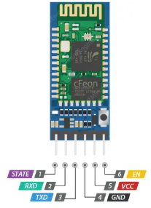
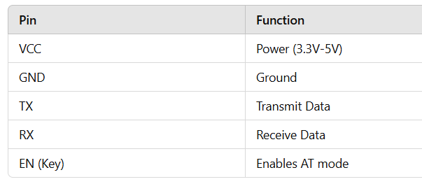
HC-05 Bluetooth Module Pin Configuration

Slide 7
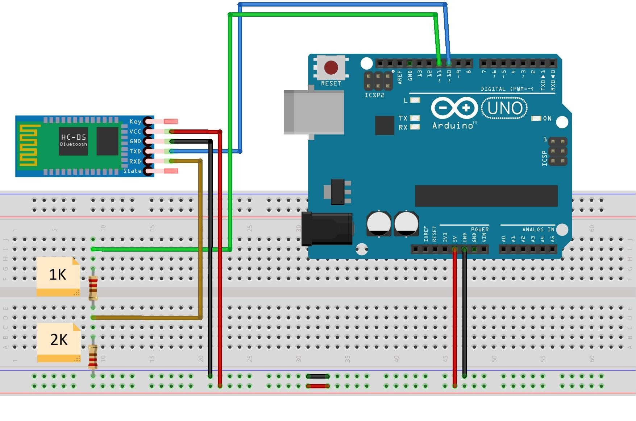
HC-05 Interfacing with Arduino Circuit Diagram

Slide 8
HC-05 Interfacing with Arduino Microcontroller Code
#include <SoftwareSerial.h>
// Create software serial object to communicate with HC-05
SoftwareSerial mySerial(10, 11); // HC-05 Tx -> Arduino 10, HC-05 Rx -> Arduino 11
void setup() {
// Begin serial communication with Arduino IDE (Serial Monitor)
Serial.begin(9600);
// Begin serial communication with HC-05
mySerial.begin(9600);
Serial.println("Initializing...");
Serial.println("The device started, now you can pair it with Bluetooth!");
}
void loop() {
// If data is reAceived from Serial Monitor, send it to Bluetooth
if (Serial.available()) {
mySerial.write(Serial.read());
}
// If data is received from Bluetooth, send it to Serial Monitor
if (mySerial.available()) {
Serial.write(mySerial.read());
}
delay(20); // Small delay to improve stability
}

Slide 9

HC-05 Bluetooth Module Applications
Industrial Automation: Enables remote monitoring and control of machines, improving efficiency and reducing manual intervention.
IoT & Home Automation: Facilitates wireless control of smart home devices, allowing automation of appliances via mobile apps.
Robotics & Remote Control: Supports wireless communication for robot navigation, making remote operation and data exchange seamless.
Healthcare & Wearable Devices: Used in smart healthcare systems for wireless patient monitoring and health tracking through Bluetooth-enabled devices.
Wireless Data Transfer: Replaces wired UART communication, enabling secure and efficient data exchange between microcontrollers and smart devices.

Slide 10
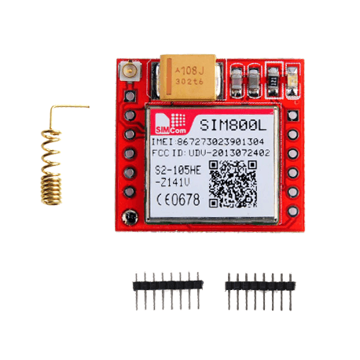
SIM800L GSM Module
The SIM800L is a GSM/GPRS module that allows your Arduino to connect to cellular networks for communication, making it suitable for sending SMS, making calls, and connecting to the internet via GPRS. Here’s an overview and a simple code example to get you started.
Key Features:
GSM/GPRS Communication: Send SMS, make calls, and use data.
Voltage: 3.4V to 4.4V (often powered with 4V).
Communication Interface: Serial (UART).
Functions: SMS, voice calls, data (GPRS), and more.

Slide 11
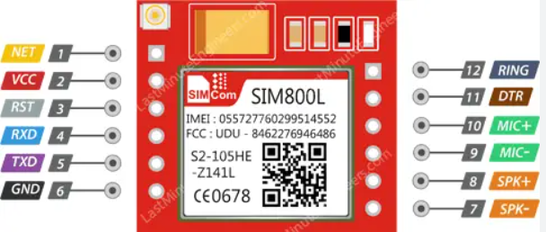
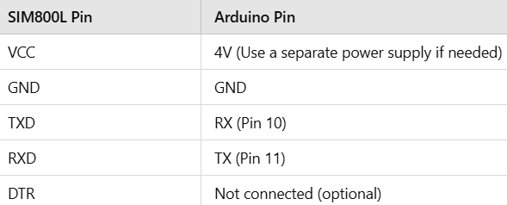
SIM800L Pin Configuration
Power Supply: The SIM800L requires stable voltage (3.4V to 4.4V) and a separate power source (as Arduino’s 5V pin may not supply enough current).
Antennas: Ensure connect the antenna for better reception.
GSM Signal: Make sure SIM card is active and has a good signal.

Slide 12
SIM800L Working Principle
How it works:
1. AT Commands: Sends basic AT commands to the SIM800L for SMS functionality.
2. Serial Communication: Uses SoftwareSerial to communicate with the SIM800L, forwarding data between the Arduino and SIM800L, and the Arduino and the Serial Monitor.
3. SMS: The code sends the "Hello World!" SMS message to a phone number (+ZZxxxxxxxxxx). Make sure to replace it with an actual phone number with country code.

Slide 13
SIM800L with Arduino

Slide 14
SIM800L with Arduino Code
#include <SoftwareSerial.h>
SoftwareSerial sim800l(3, 2); // RX, TX pins connected to SIM800L
void setup() {
// Begin serial communication with Serial Monitor and SIM800L
Serial.begin(9600);
sim800l.begin(9600);
// Wait for the SIM800L module to initialize
delay(1000);
// Send SMS
sendSMS("1234567890", "Hello from SIM800L!");
Serial.println("SMS sent!");
}
void loop() {
// You can add code to listen for incoming messages or calls
}
// Function to send SMS
void sendSMS(String phoneNumber, String message)
{
sim800l.print("AT+CMGF=1\r"); // Set SMS format to text mode
delay(500);
sim800l.print("AT+CMGS=\""+phoneNumber+"\"\r"); //Set the recipient phone number
delay(500);
sim800l.print(message); // Send message
delay(500);
sim800l.write(26); // ASCII code for sending the SMS
delay(500);
}

Slide 15
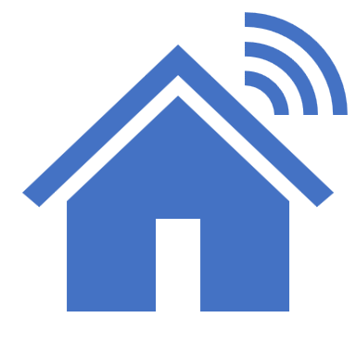
HC-05 Bluetooth Module Applications
SMS-based Communication: Send SMS alerts, control devices remotely, or create alert systems for emergencies.
Voice Communication: Enable voice calls or intercom systems.
GPRS Data Communication: Provide internet access, send data from sensors, or enable GPS tracking.
IoT Projects: Used in remote IoT devices for monitoring and automation, such as in agriculture or smart home systems
Home Automation & Security: Control appliances via SMS or phone calls and send alerts for

Slide 16
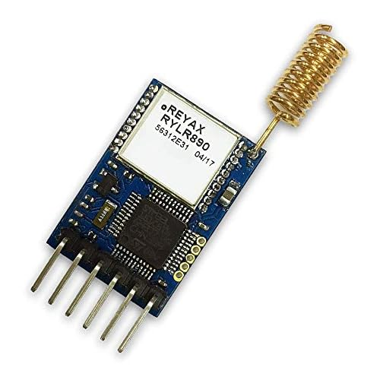

LoRa Module
LoRa (Long Range) Module is a wireless communication technology designed for long-distance, low-power data transmission.
It operates on unlicensed ISM bands (e.g., 433MHz, 868MHz, 915MHz) and is widely used in IoT applications.
How LoRa Works
Uses Chirp Spread Spectrum (CSS) modulation for robust, interference-resistant communication.
Supports Point-to-Point (direct node communication) and LoRaWAN (network-based) communication.
Can transmit data up to 10-15 km in open areas with low power consumption.

Slide 17
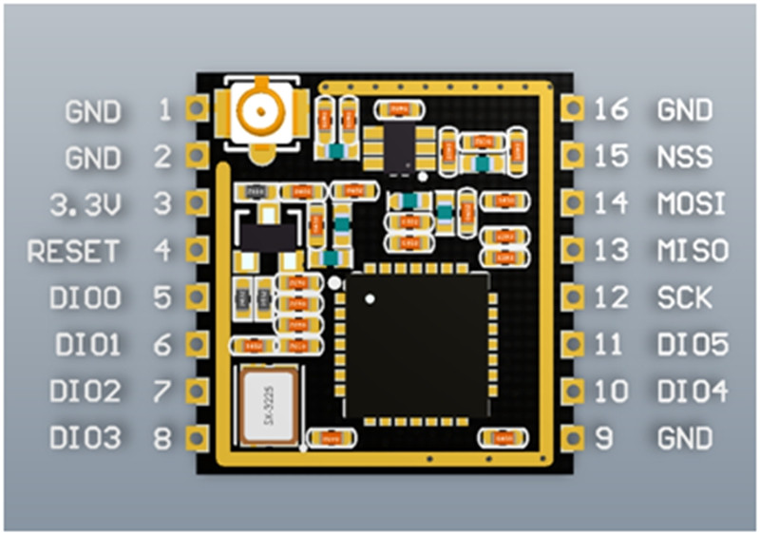
Pin Diagram of LoRa Module

Slide 18
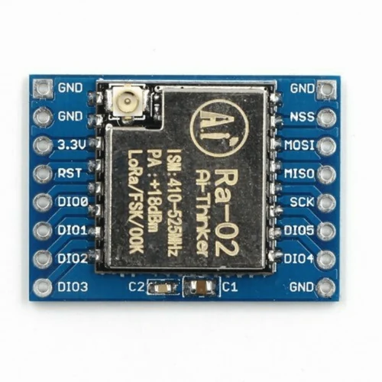
Pin Diagram of LoRa Module

Slide 19
Pin Diagram of LoRa Module with Arduino
LoRa Module Pin Arduino Pin
MISO Pin 12
MOSI Pin 11
SCK Pin 13
NSS (CS) Pin 10
RESET Pin 9
DIO0 Pin 2
GND GND
VCC (3.3V) 3.3V (Important!)
Note: The LoRa module operates at 3.3V, so ensure you’re using the 3.3V pin for power. Also, the logic level is 3.3V, so if you are using a 5V Arduino, it’s safer to use level shifters for the SPI pins (although many users get by without them).

Slide 20
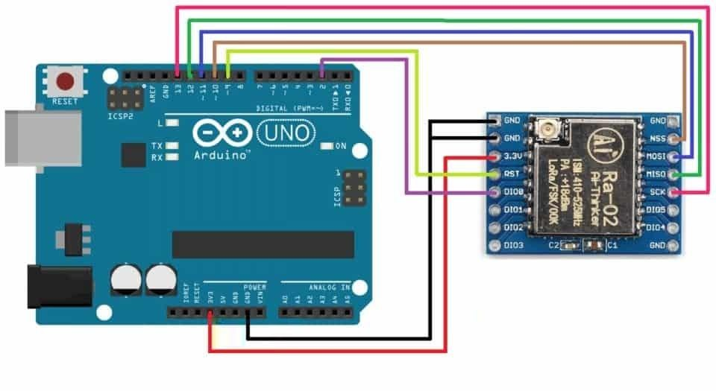
LoRa Module with Arduino

Slide 21
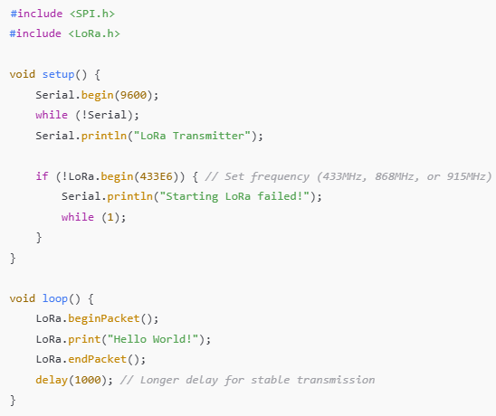
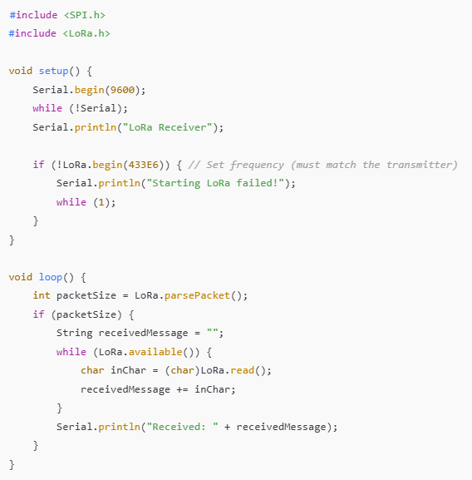
LoRa Module with Arduino Code
Transmitter Code:
Receiver Code:

Slide 22
Applications of LoRa Module
Smart Agriculture: Remote monitoring of soil, weather, and irrigation.
Industrial Automation: Wireless sensor networks for equipment monitoring.
Smart Cities: Parking systems, waste management, and streetlights.
Environmental Monitoring: Air pollution, water quality, and weather stations.

Slide 23
Generic RF Module
A Generic RF (Radio Frequency) Module is a wireless communication device that transmits and receives data over radio waves.
It consists of:
1. RF Transmitter (TX): Sends encoded signals.
2. RF Receiver (RX): Captures and decodes signals.
Common Frequencies: 315MHz, 433MHz, 868MHz, 915MHz. Used for: Low-power, short-range communication in IoT, remote controls, and automation.

Slide 24
Signal Transmission:
The transmitter converts digital data into an RF signal and sends it via an antenna.
The receiver detects and decodes the signal into usable data.
Modulation Techniques:
ASK (Amplitude Shift Keying): Simple, low-cost, but prone to interference.
FSK (Frequency Shift Keying): More reliable and resistant to noise.
Microcontroller Interface:
Can be easily connected to Arduino, Raspberry Pi, or any microcontroller using simple digital I/O pins.
Generic RF Module

Slide 25
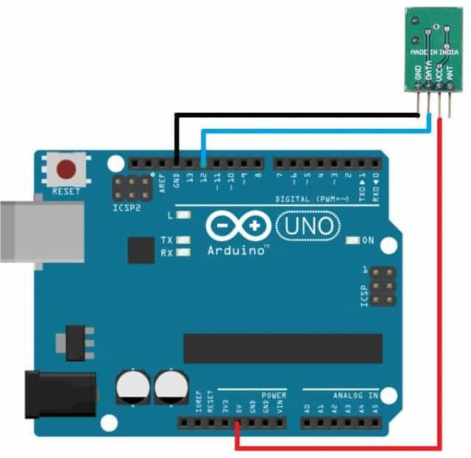
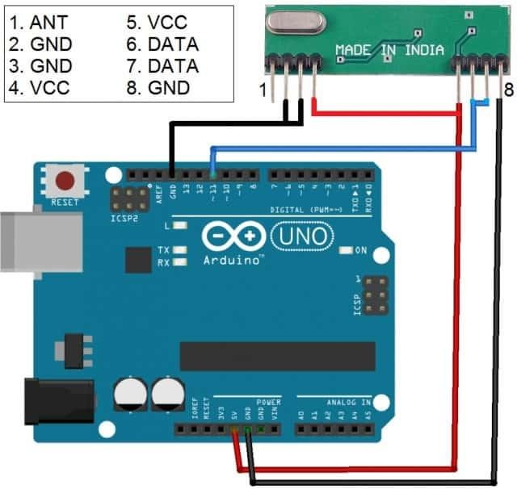
Generic RF Module

Slide 26
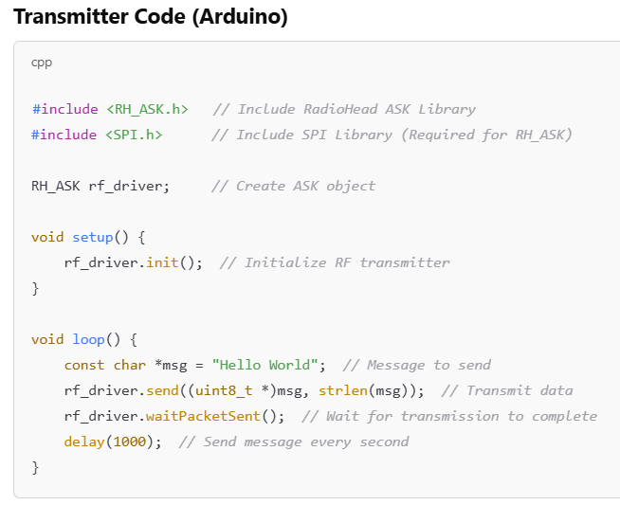
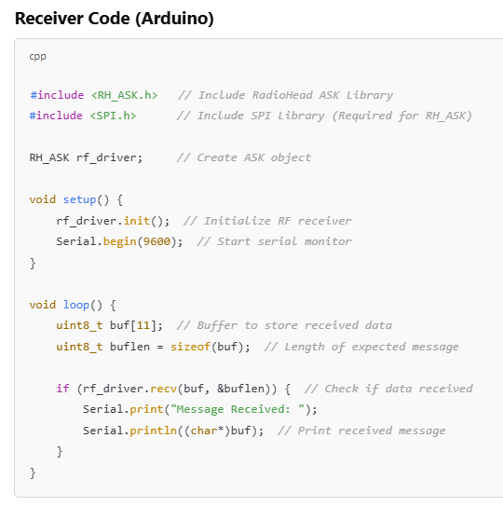
Generic RF Module

Slide 27
Applications of Generic RF Module
Remote Control Systems – Used in wireless remotes for TVs, gates, and car locking systems.
Home Automation – Enables smart home devices like wireless switches and alarms.
Wireless Sensor Networks – Transfers data from remote sensors for monitoring.
Industrial Automation – Provides machine-to-machine (M2M) communication.
Security Systems – Used in RFID-based access control and burglar alarms.

Slide 28
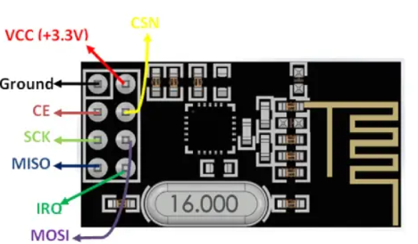
nRF24L01 RF Module
The nRF24L01 is a low-power, highly integrated 2.4 GHz transceiver module designed for wireless communication.
Key Features:
Frequency Range: 2.4 GHz ISM band
Communication Distance: Up to 100 meters (line of sight)
Data Rate: 250 kbps, 1 Mbps, 2 Mbps
Low Power Consumption: 12.3 µA in power-down mode
Supports Point-to-Point & Multi-Point Communication

Slide 29
nRF24L01 RF Module Advantages
Low Power: Perfect for battery-operated devices.
High Communication Range: Ideal for IoT applications.
Easy to Integrate: Supports SPI for simple communication with microcontrollers like Arduino and Raspberry Pi.
Reliable: Uses Frequency Hopping Spread Spectrum (FHSS) to reduce interference.

Slide 30
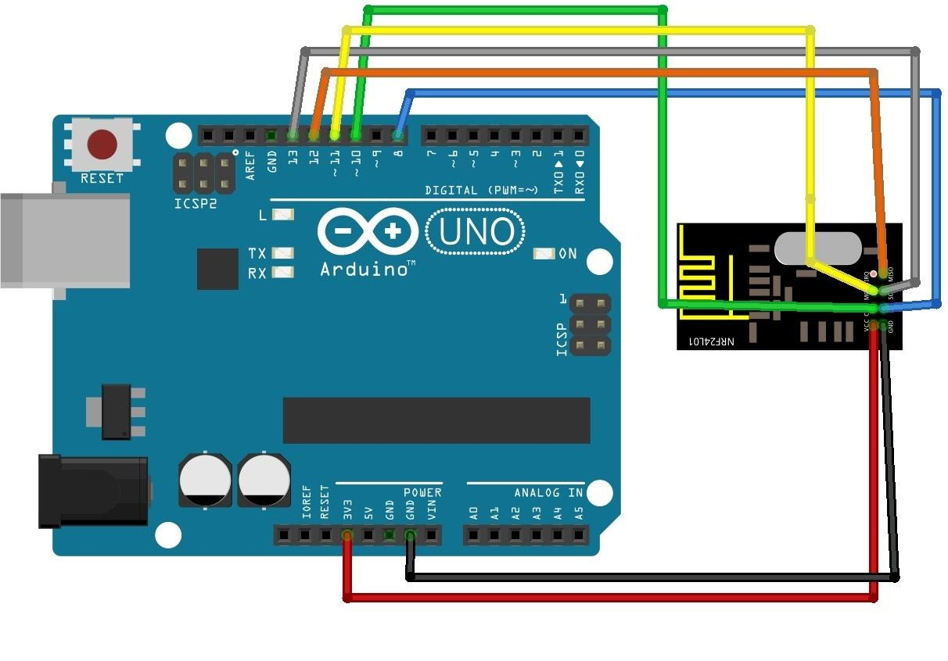
nRF24L01 RF Module

Slide 31
nRF24L01 RF Module
Transmitter Code:
Receiver Code:
// Include Libraries
#include <SPI.h>
#include <nRF24L01.h>
#include <RF24.h>
// Create an RF24 object
RF24 radio(9, 8); // CE, CSN
// Address through which two modules communicate
const byte address[6] = "00001";
void setup() {
radio.begin();
// Set the address
radio.openWritingPipe(address);
// Set module as transmitter
radio.stopListening();
}
void loop() {
// Send message to receiver
const char text[] = "Hello World";
radio.write(&text, sizeof(text));
delay(1000);
}
// Include Libraries
#include <SPI.h>
#include <nRF24L01.h>
#include <RF24.h>
// Create an RF24 object
RF24 radio(9, 8); // CE, CSN
// Address through which two modules communicate const byte address[6] = "00001";
void setup() {
while (!Serial);
Serial.begin(9600);
radio.begin();
// Set the addressradio.openReadingPipe(0, address);
// Set module as receiver
radio.startListening();
}
void loop() {
// Read the data if available in buffer
if (radio.available()) {
char text[32] = {0};
radio.read(&text, sizeof(text));
Serial.println(text);
}
}

Slide 32
nRF24L01 RF Module Applications
Wireless Sensor Networks – Remote data collection from environmental or industrial sensors.
Home Automation – Wireless control of smart devices like lights, fans, and door locks.
IoT Applications – Seamless communication between IoT devices for real-time monitoring and control.
Robotics and Automation – Wireless control and coordination of robots and automated systems.
Remote Control Systems – Stable, long-range control for RC cars, drones, and robotic projects.

Slide 33
THANK YOU

